Slide 1
Fashion-MNIST Classification
Comparative Analysis of ANN vs CNN
Student Name: Oritseweyinmi Mabamije
Student ID: P2783241

Slide 2

Content
Project Overview
Dataset & Preprocessing
Model Architectures
Training Setup
Training Results
Key Findings & Analysis
Conclusion

Slide 3

Project Overview
Objective: Design and compare neural network models being ANN and CNN performance on Fashion-MNIST classification
Datasets: 60,000 training + 10,000 test images, 28*28 images across 10 clothing categories
Models: ANN with 242k trainable params vs CNN with 241k trainable params
Goal: Evaluate model accuracy, analyze performance, observe strenghts and weaknesses .

Slide 4
Dataset & Preprocessing
Data Split: 90% training (54K), 10% validation (12K) and 10K test images
Load the dataset: Use the Fashion-MNIST dataset available tensorflow.keras.datasets.
Normalization: Applied a scale pixel values between 0 and 1.
Data Augumentation: zooming images, horizontal flipping for training and rotating of images.
Classes: T-shirt, Trouser, Pullover, Dress, Coat, Sandal, Shirt, Sneaker, Bag, Ankle boot

Slide 5
Model Architectures
Basic ANN: 3 hidden layers(256-64 neurons), Relu activation.
Improved ANN: Added dropout regularisation to reduce overfitting
Basic CNN: 3 convolutional layers ( 32, 64 and 128), ReLU + MaxPooling
Improved CNN: Added Data Augumentation and Dropout for better stability and accuracy

Slide 6
Training Setup
Optimiser: Adam with a learning rate of 0.001
Loss Function: CrossEntropyLoss
Hardware: Runs on CPU or GPU automatically
Epochs: 10-25, depending on model complexity.

Slide 7
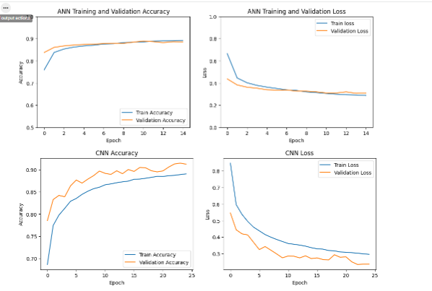
Training Results- Learning Curves

Slide 8
Training Results
ANN Results: Accuracy : 88% Converged: Epoch 10
CNN Results: Accuracy: 90% Converged: Epoch 8
Overfitting: both show healthy generalization

Slide 9
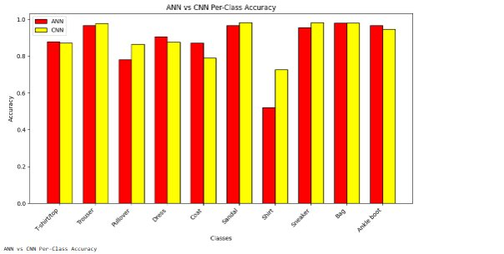
Per-Class Accuracy Breakdown

Slide 10
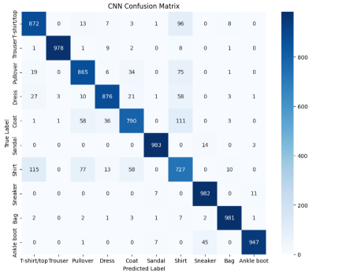
Confusion Matrix – CNN Performance

Slide 11
Key Findings & Analysis
CNN outperforms ANN with accuracy of 90% vs 88% respectively due to spatial feature extraction from images
Dropout and Data augmentation improves generalization and reduce overfitting
Visually similar classes(Shirt vs T-shirt) showed reduced confusion in CNN

Slide 12

Conclusion
CNN achieved 90% test accuracy overpowering all ANN variants
CNN are best choice for visual pattern recognition tasks
Apply advanced batch normalisation for improvements

